Slide 1
JVM ARCHITECTURE

Slide 2
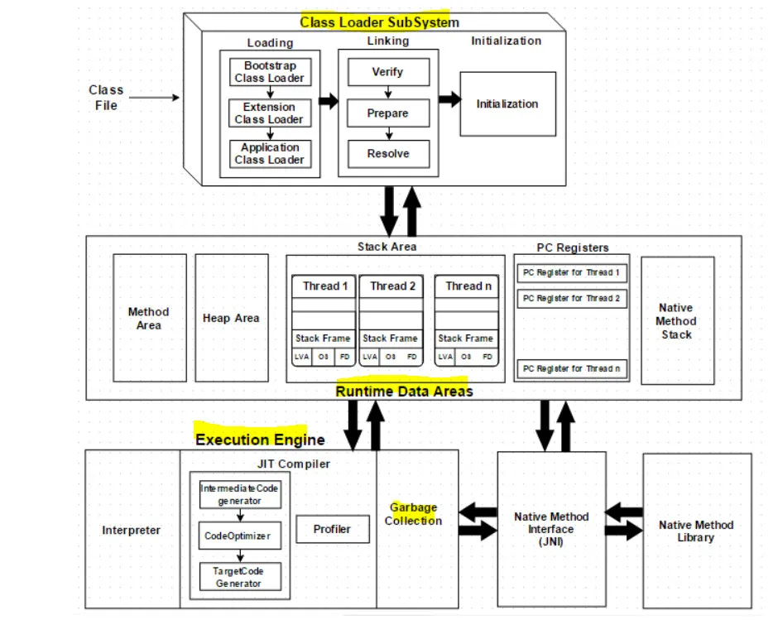

Slide 3
The JVM is divided into three main subsystems:
⦁ Class Loader Subsystem
⦁ Runtime Data Area
⦁ Execution Engine

Slide 4
1. Class Loader Subsystem
Java’s dynamic class loading functionality is handled by the class loader subsystem. It loads, links. and initializes the class file when it refers to a class for the first time at runtime, not compile time.

Slide 5
1.1 Loading
Classes will be loaded by this component. Boot Strap class Loader, Extension class Loader, and Application class Loader are the three class loader which will help in achieving it.

Slide 6
1.1 Loading
Boot Strap ClassLoader — Responsible for loading classes from the bootstrap classpath, nothing but rt.jar. Highest priority will be given to this loader.
Extension ClassLoader — Responsible for loading classes which are inside ext folder (jre\lib).
Application ClassLoader –Responsible for loading Application Level Classpath, path mentioned Environment Variable etc.

Slide 7
1.2 Linking
Verify — Bytecode verifier will verify whether the generated bytecode is proper or not if verification fails, we will get the verification error.
Prepare — For all static variable's memory will be allocated and assigned with default values.
Resolve — All symbolic memory references are replaced with the original references from Method Area.

Slide 8
1.3 Initialization
This is the final phase of Class Loading, here all static variables will be assigned with the original values, and the static block will be executed.

Slide 9
2. Runtime Data Area
1.Method Area — All the class level data will be stored here, including static variables. There is only one method area per JVM, and it is a shared resource.

Slide 10
2. Runtime Data Area
2.Heap Area — All the Objects and their corresponding instance variables and arrays will be stored here. There is also one Heap Area per JVM. Since the Method and Heap areas share memory for multiple threads, the data stored is not thread safe.

Slide 11
2. Runtime Data Area
3.Stack Area — For every thread, a separate runtime stack will be created. For every method call, one entry will be made in the stack memory which is called as Stack Frame. All local variables will be created in the stack memory. The stack area is thread safe since it is not a shared resource. The Stack Frame is divided into three sub entities:

Slide 12
2. Runtime Data Area
Local Variable Array — Related to the method how many local variables are involved and the corresponding values will be stored here.
Operand stack — If any intermediate operation is required to perform, operand stack acts as runtime workspace to perform the operation.
Frame data — All symbols corresponding to the method is stored here. In the case of any exception, the catch block information will be maintained in the frame data.

Slide 13
4.PC Registers
Each thread will have separate PC Registers, to hold the address of current executing instruction once the instruction is executed the PC register will be updated with the next instruction.

Slide 14
5.Native Method stacks
Native Method Stack holds native method information. For every thread, a separate native method stack will be created.

Slide 15
3. Execution Engine
The bytecode which is assigned to the Runtime Data Area will be executed by the Execution Engine. The Execution Engine reads the bytecode and executes it piece by piece.
1.Interpreter — The interpreter interprets the bytecode faster, but executes slowly. The disadvantage of the interpreter is that when one method is called multiple times, every time a new interpretation is required.

Slide 16
3. Execution Engine
2.JIT Compiler — The JIT Compiler neutralizes the disadvantage of the interpreter. The Execution Engine will be using the help of the interpreter in converting byte code, but when it finds repeated code it uses the JIT compiler, which compiles the entire bytecode and changes it to native code. This native code will be used directly for repeated method calls, which improve the performance of the system.

Slide 17
3. Execution Engine
Intermediate Code generator — Produces intermediate code
Code Optimizer — Responsible for optimizing the intermediate code generated above
Target Code Generator — Responsible for Generating Machine Code or Native Code
Profiler — A special component, responsible for finding hotspots, i.e. whether the method is called multiple times or not.

Slide 18
3.Garbage Collector
Collects and removes unreferenced objects. Garbage Collection can be triggered by calling “System.gc()”, but the execution is not guaranteed. Garbage collection of the JVM collects the objects that are created.
Java Native Interface (JNI) — JNI will be interacting with the Native Method Libraries and provides the Native Libraries required for the Execution Engine.
Native Method Libraries — It is a collection of the Native Libraries which is required for the Execution Engine.

Slide 19
THANK YOU

